Slide 1
UCSD Embedded RTOS Assignment 6
By
Hsuankai Chang
hsuankac@umich.edu

Slide 2
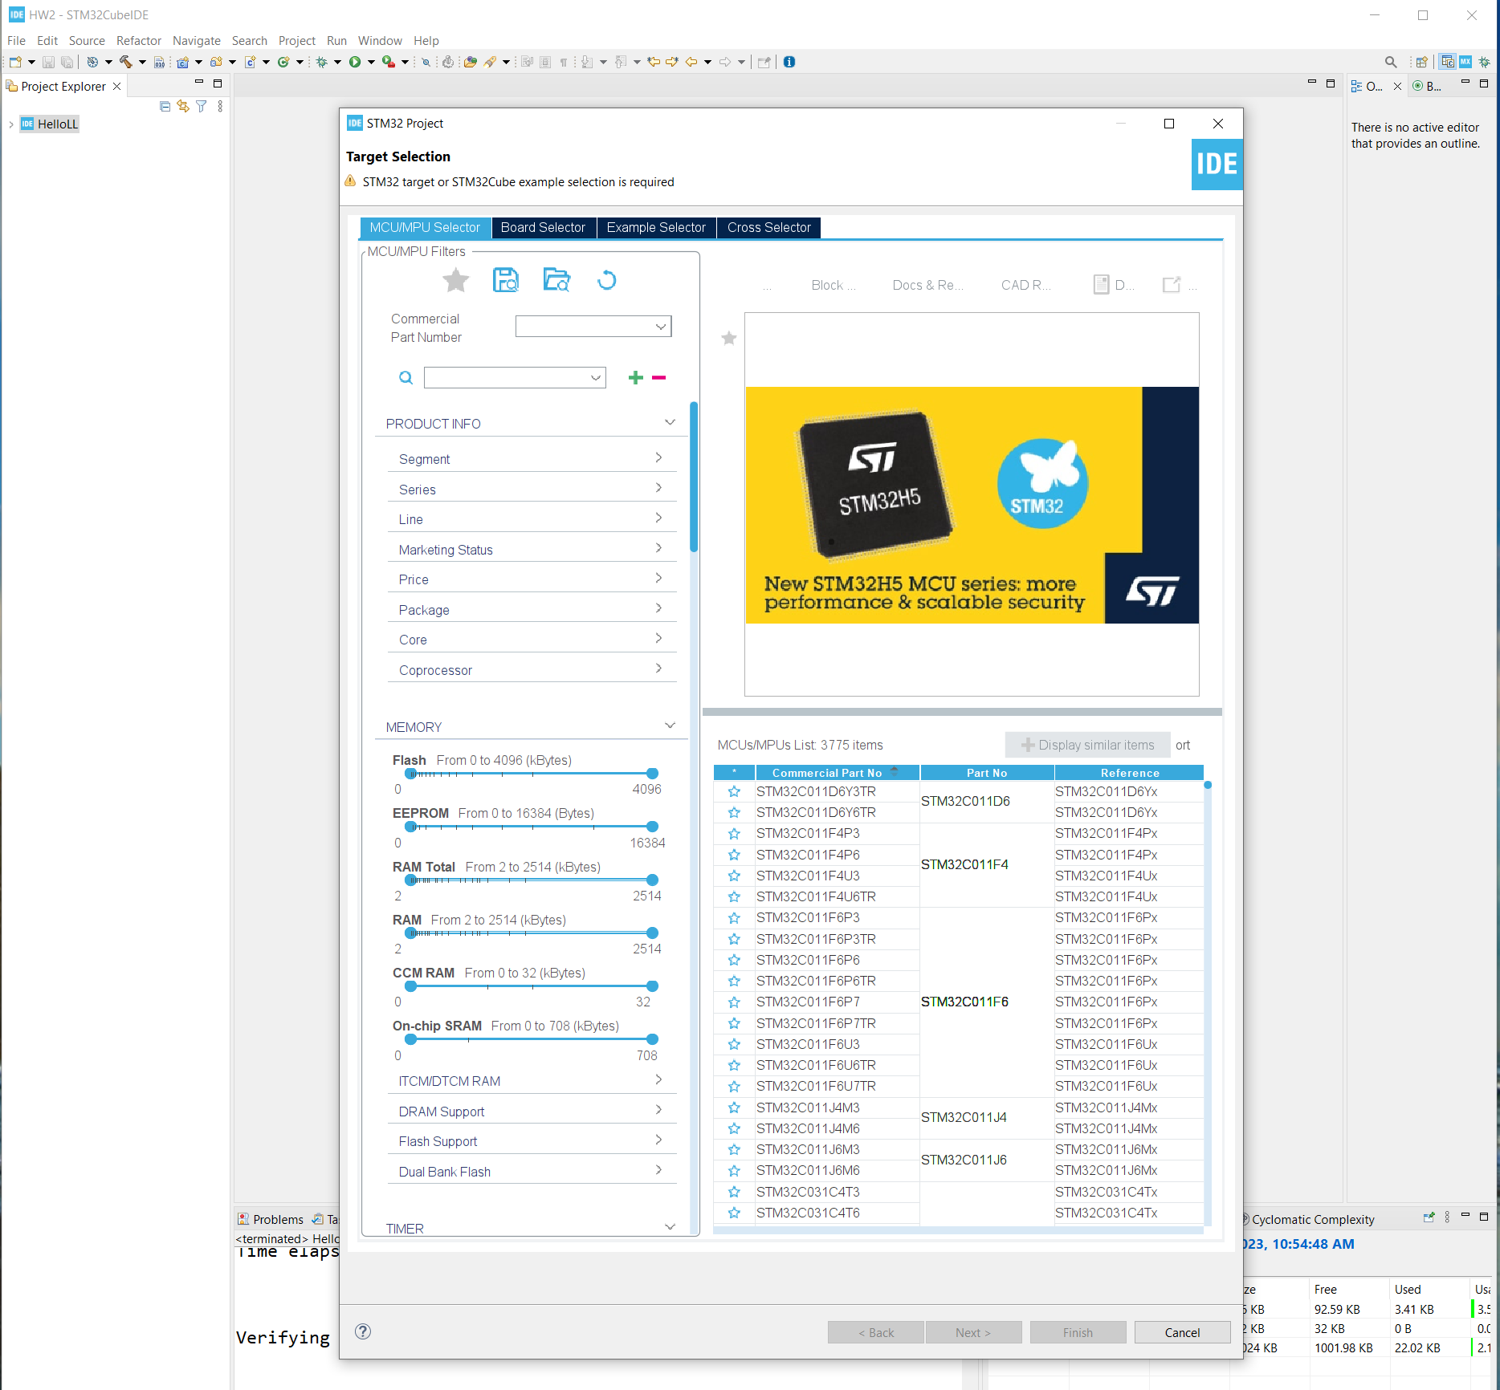
Step 1. Startup STM32CubeIDE and create new STM32 project

Slide 3
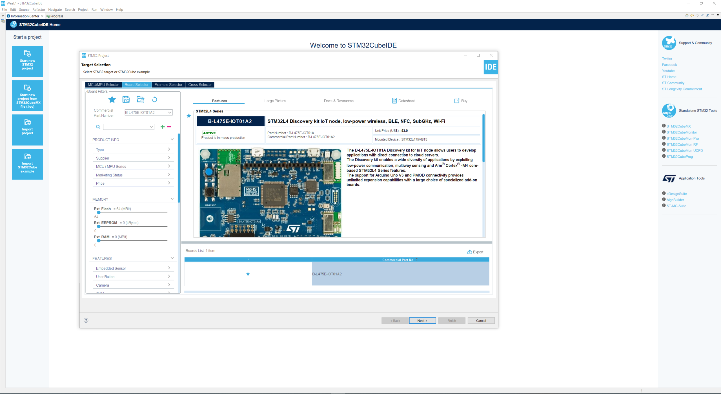
Step 2. Access board selector and type in the board you use, click Next

Slide 4
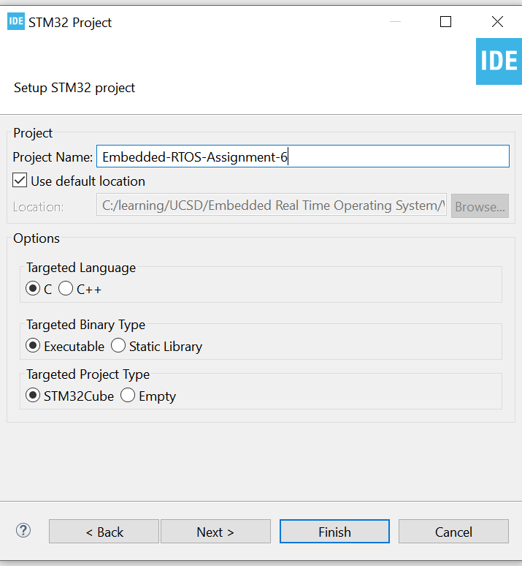
Step 3. Enter the project name then click Next

Slide 5
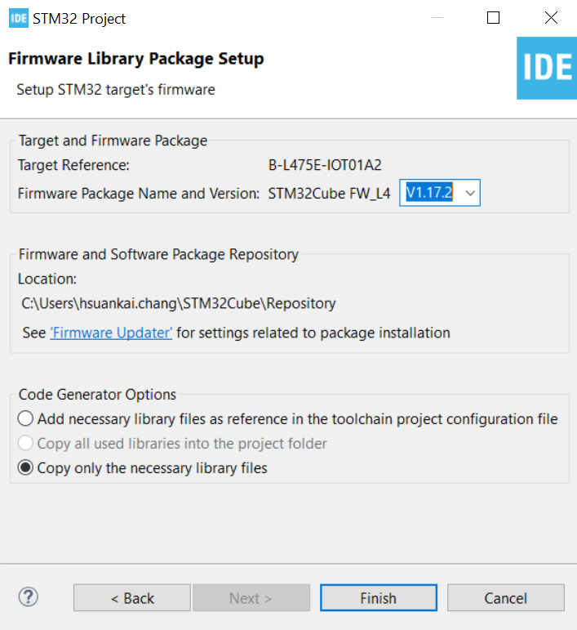
Step 4. See the firmware package name and version

Slide 6
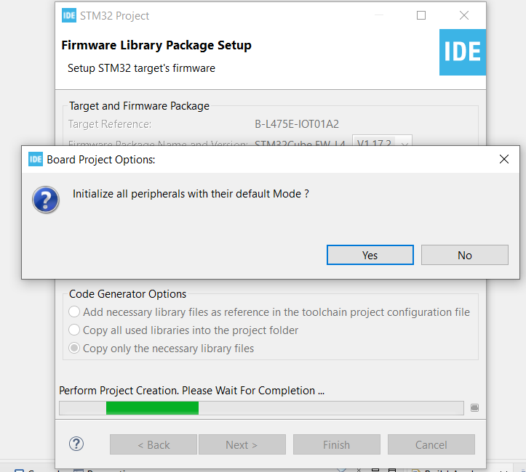
Step 5. Click yes to initialize all peripherals to default

Slide 7
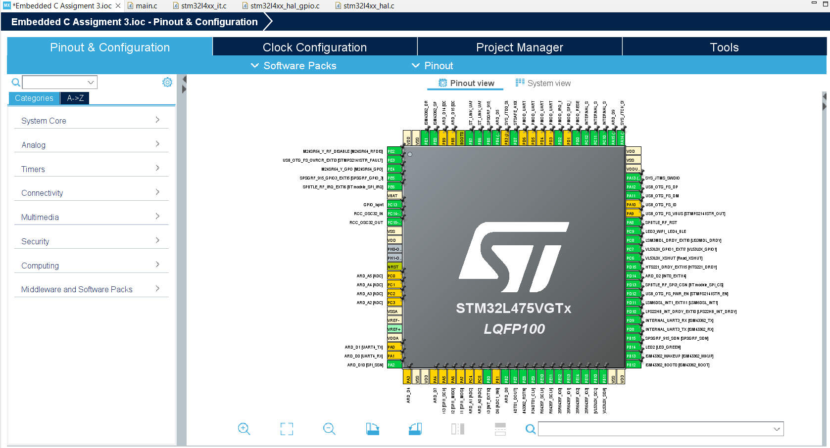
Step 6. When in .ioc file, click Pinout & Configurations

Slide 8
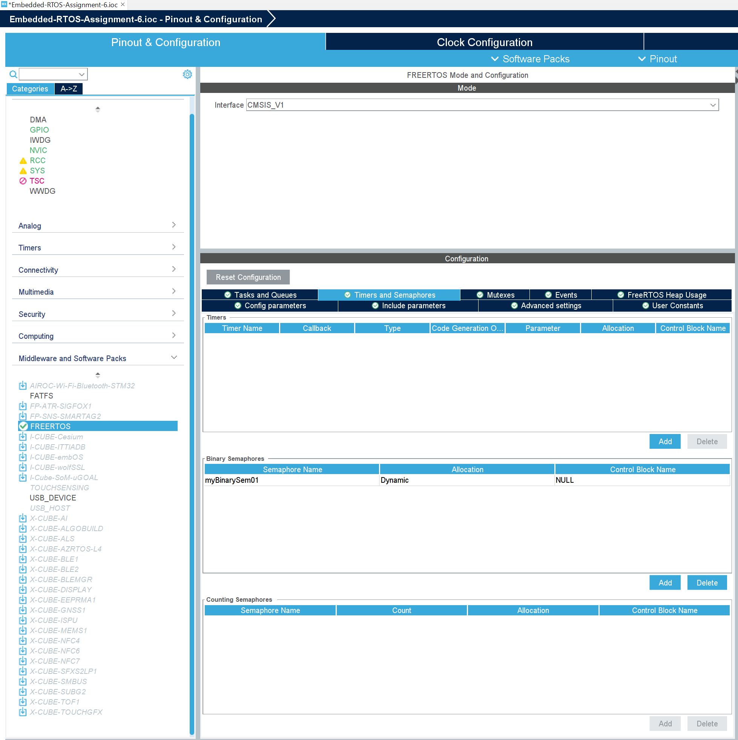
Step 7. Enable FreeRTOS CMSIS_V1 and add binary semaphore.

Slide 9
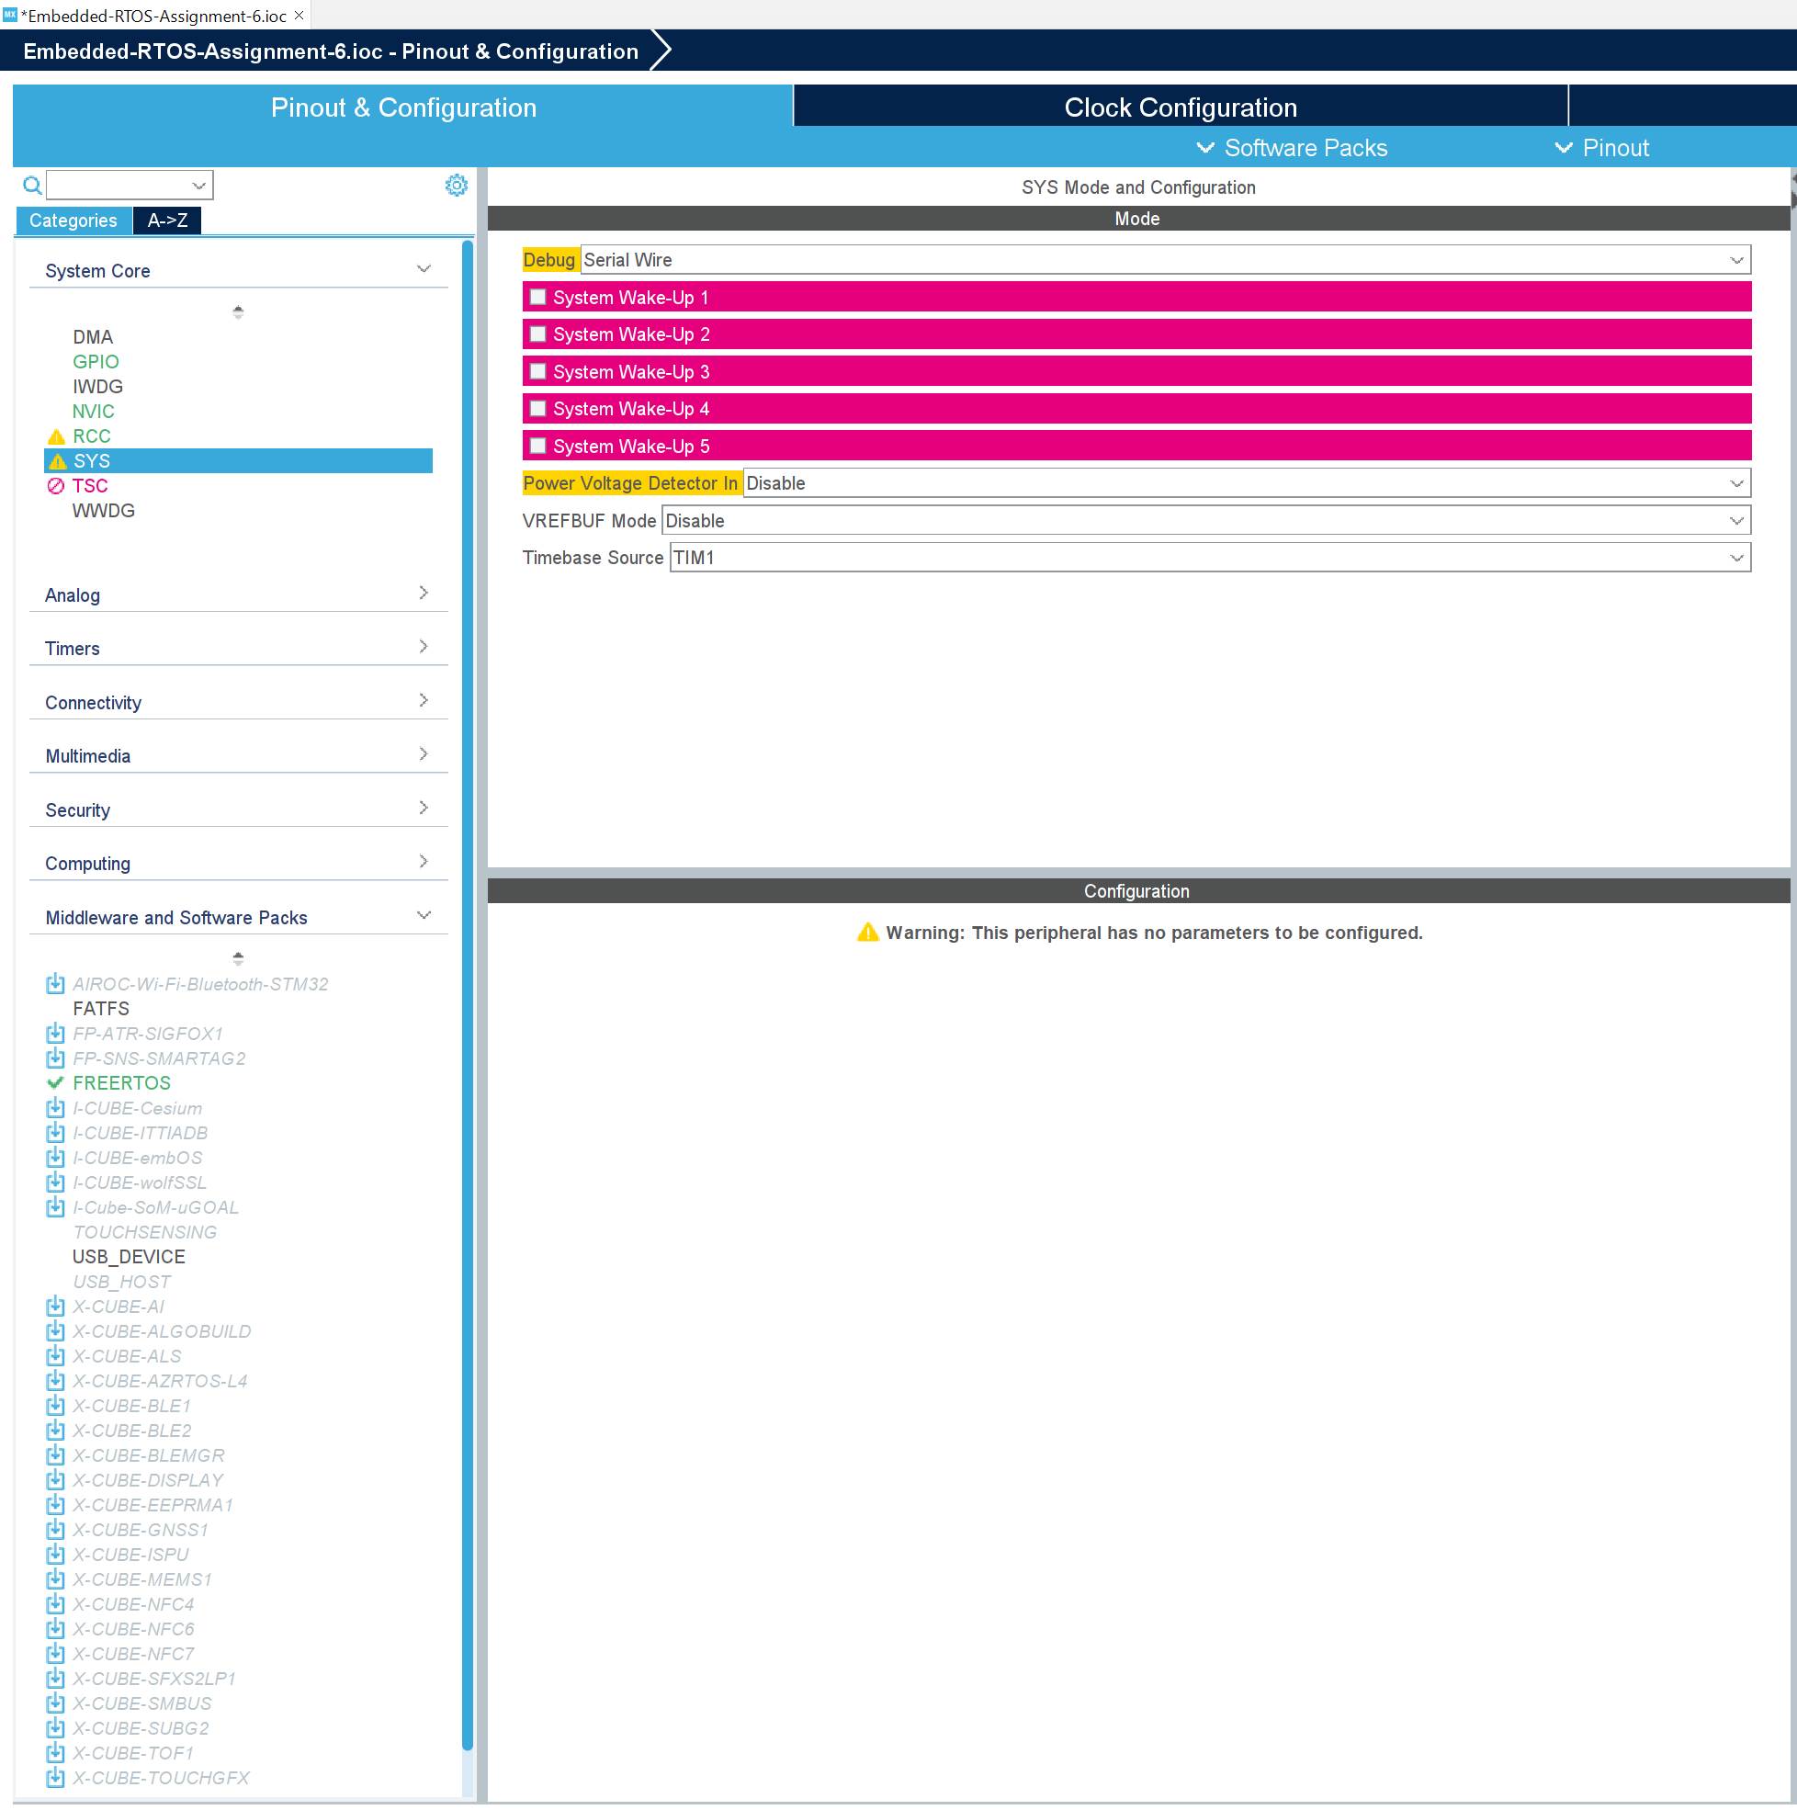
Step 8. Change Timebase from systick to TIM1

Slide 10
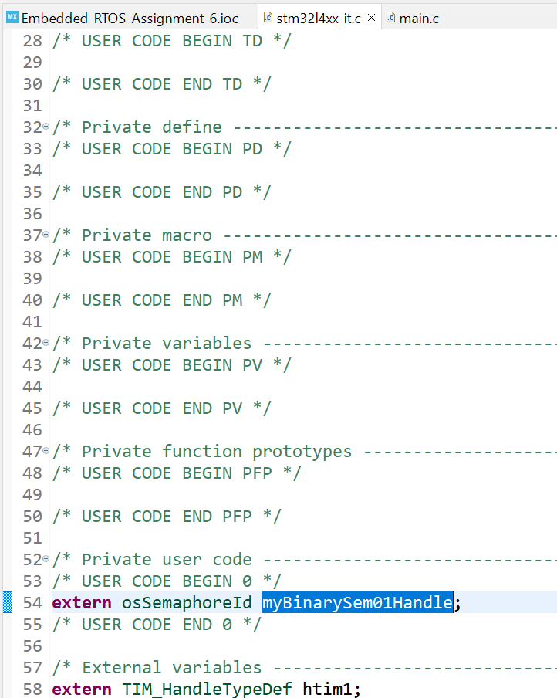
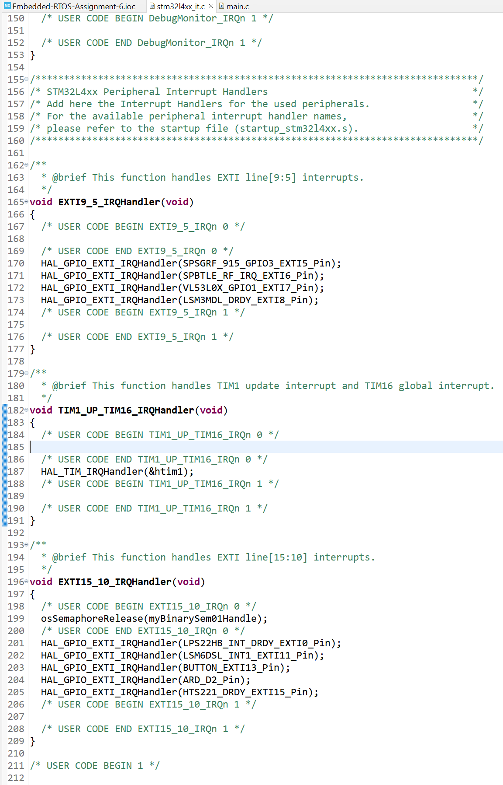
Step 9. Add release semaphore code in interrupt source file, don’t forget to include necessary header file for osSemaphoreId

Slide 11
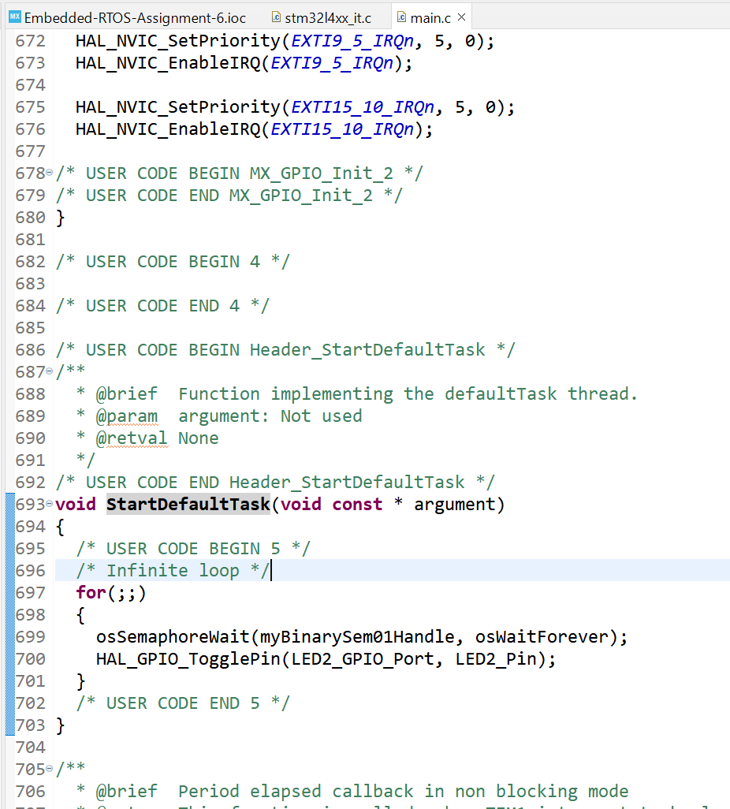
Step 10. In task function, get the semaphore and toggle LED2

Slide 12
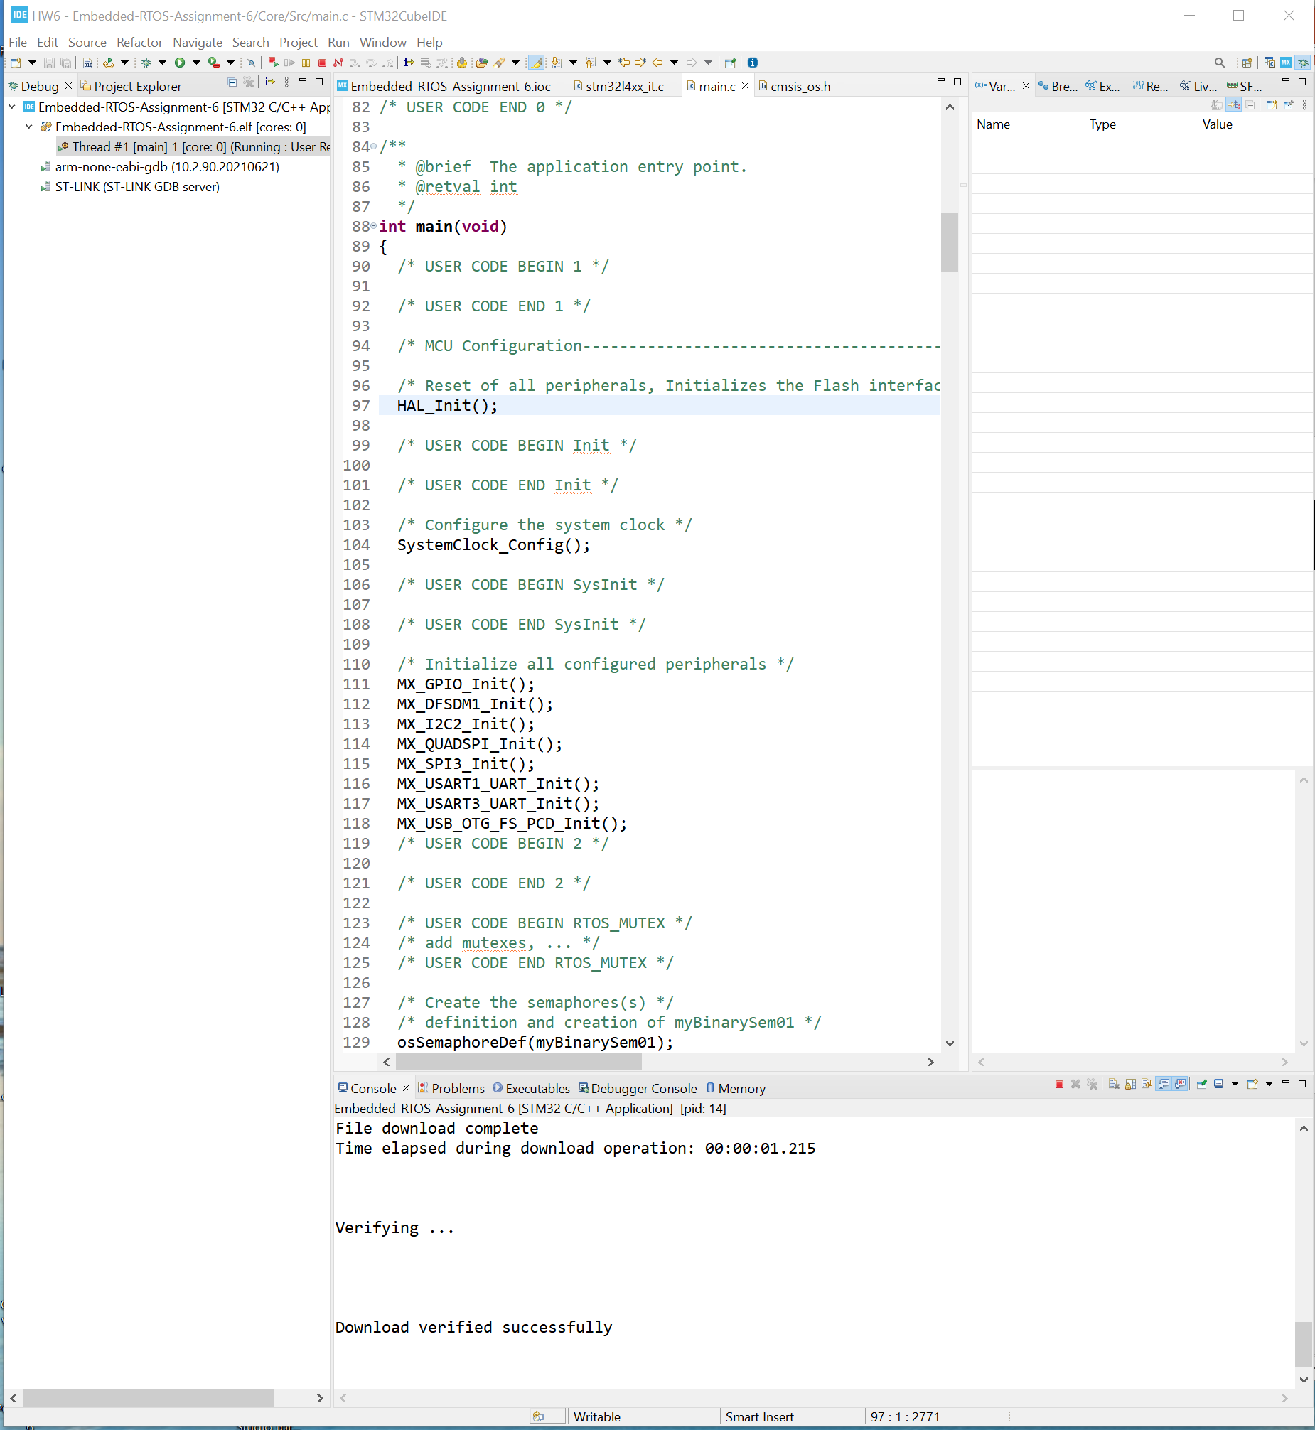
Step 11. Compile and run the code, test is successful

